Slide 1
TCL(TOOL COMMAND LANGUAGE)

Slide 2
Why TCL?
Tcl is a very simple language that you can learn quickly and keep in your head. It is a mature platform, with a comprehensive standard library. Unlike some other scripting languages, Tcl is stable and does not require complex virtual environment or dependency management. To get started, all you need is the interpreter tclsh and the standard library tcllib.
Efficiency: TCL automation dramatically reduces manual effort, accelerating design processes.
Accuracy: By automating repetitive tasks, TCL minimizes the risk of human errors, leading to more reliable designs.
Flexibility: TCL's versatility adapts to the evolving requirements of VLSI projects, allowing us to quickly adjust to changing design needs.
Competitive Edge: TCL proficiency is a vital skill in the VLSI industry, giving you a competitive advantage in job markets.

Slide 3
Importance of TCL
Specific Domain Applications: TCL is used in specific domains such as networking, where it is employed in the automation of network devices, and in testing automation, where its simplicity aids in creating automated test scripts.
Scripting and Automation: TCL is widely used for scripting tasks and automation, especially in scenarios where quick development and ease of use are crucial.
Embeddability: Tcl's embeddability makes it valuable for incorporating scripting capabilities into existing applications. It is commonly used as an embedded scripting language in various software.
Rapid Prototyping: Tcl's simplicity and clean syntax make it well-suited for rapid prototyping. Developers can quickly create and test ideas, making it an effective tool for iterative development.
Interoperability:
Tcl has good interoperability with other languages, including C and C++. This feature facilitates integration with existing codebases and systems.

Slide 4
Puts command:
In Tcl (Tool Command Language), the puts command is used to write data to the standard output or to a specified channel. The basic syntax of the puts command is as follows:
puts ?-nonewline? ?channelId? String
-nonewline: This is an optional flag that, when present, indicates that a newline character should not be added to the end of the output.
channelId: This is an optional argument that specifies the channel to which the output should be directed. If not provided, it defaults to the standard output.
string: This is the data or string that you want to write to the specified channel.
Ex:puts $fileId "This is written to a file."

Slide 5
[], {} braces difference:
1. Square Brackets []:Square brackets are used for command substitution. When you enclose a command or expression within square brackets, Tcl evaluates that command or expression and substitutes the result in its place.
Ex: set result [expr 2 + 3]
puts $result ;# Output: 5
2.Curly Braces {}:Curly braces are used for grouping and creating a literal string or script. The content inside curly braces is treated as a literal string, and no substitution or interpretation is performed on it.
Ex: set text {This is a literal string.}
puts $text ;# Output: This is a literal string.

Slide 6
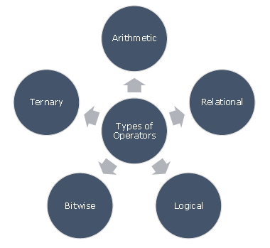
Tcl - Operators
An operator is a symbol that tells the compiler to perform specific mathematical or logical manipulations. Tcl language is rich in built-in operators and provides the following types of operators −

Slide 7
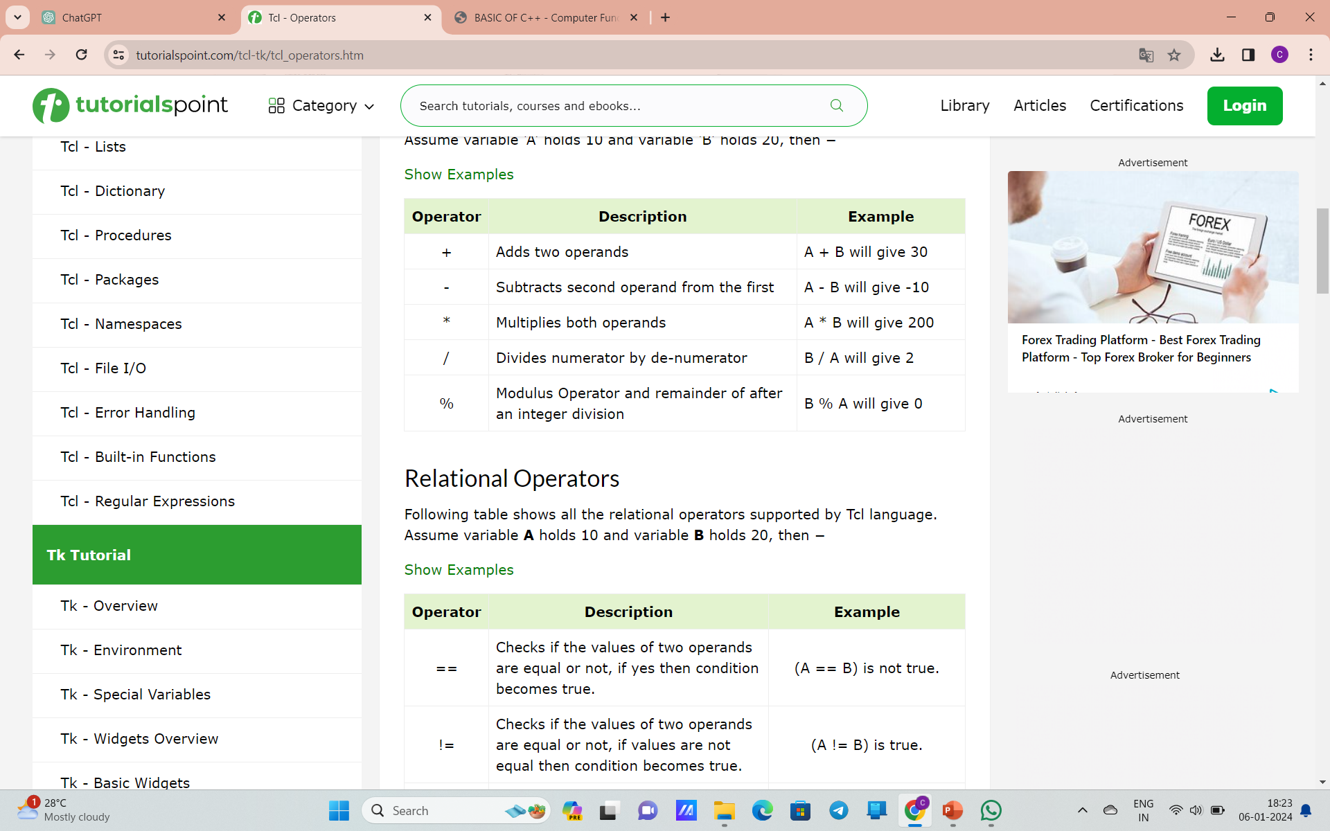
Arithmetic Operators
Assume variable ‘A’ holds 10 and variable ‘B’ holds 20, then −

Slide 8
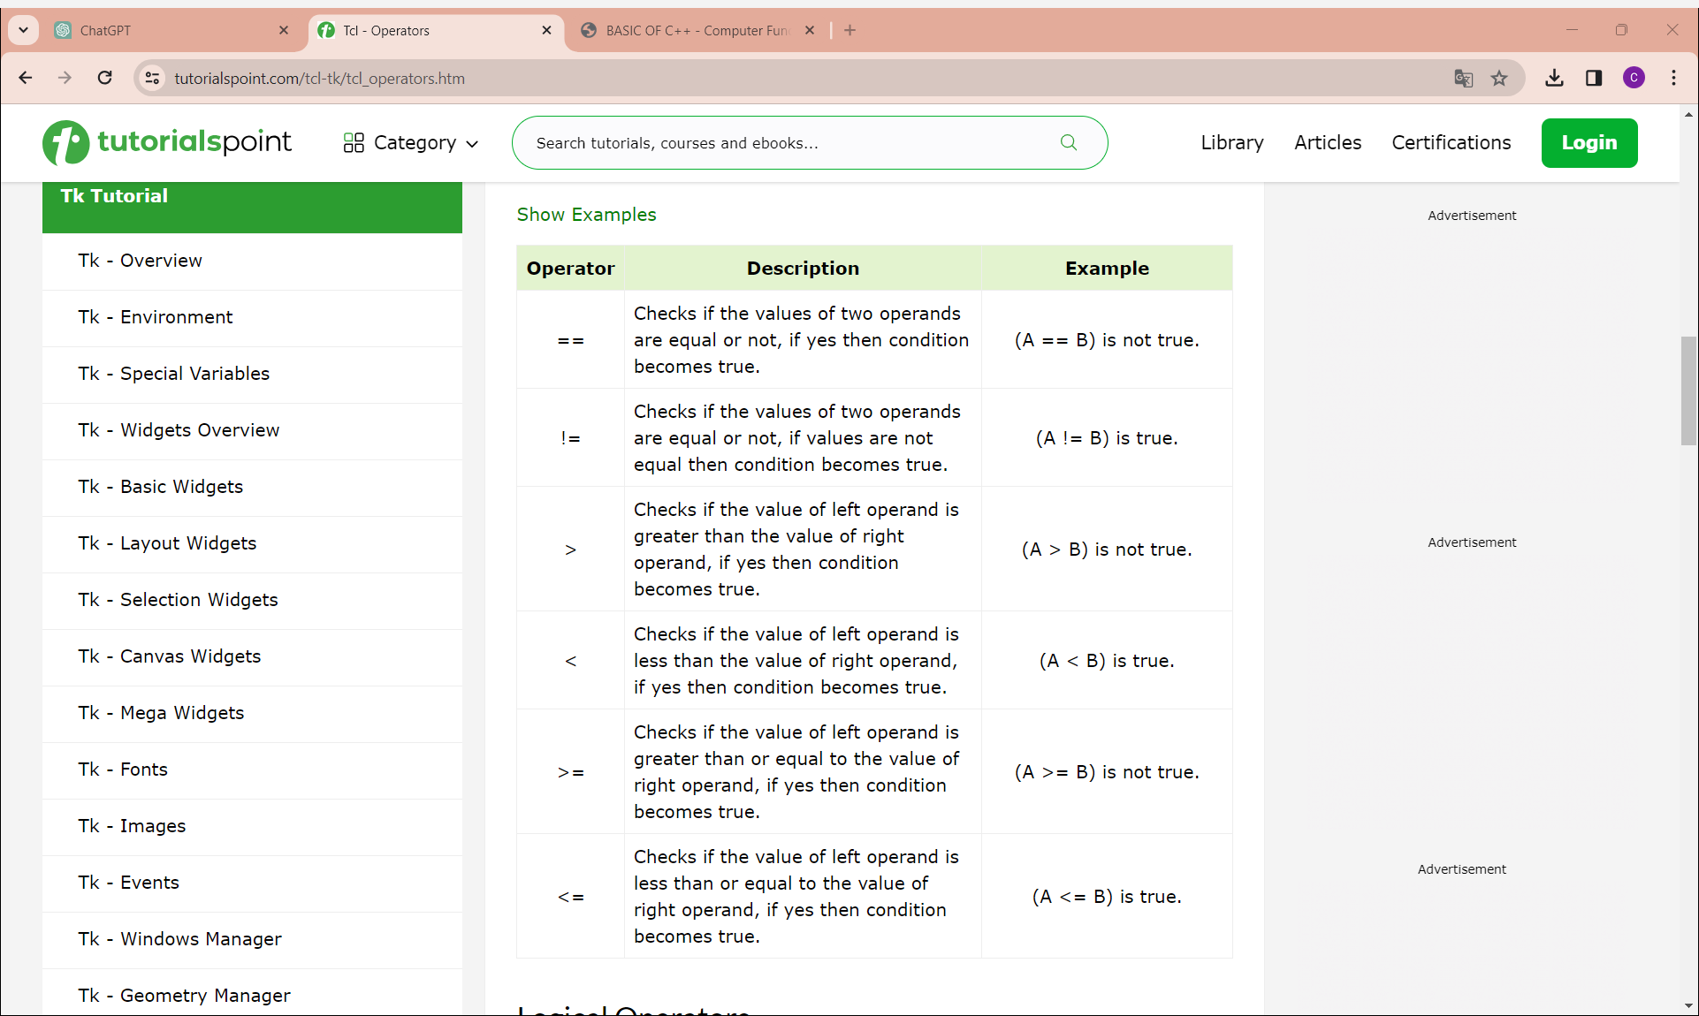
Relational Operators
These relational operators are commonly used in conditional statements, loops,
and other control structures to make decisions based on the relationships between values in Tcl scripts.

Slide 9
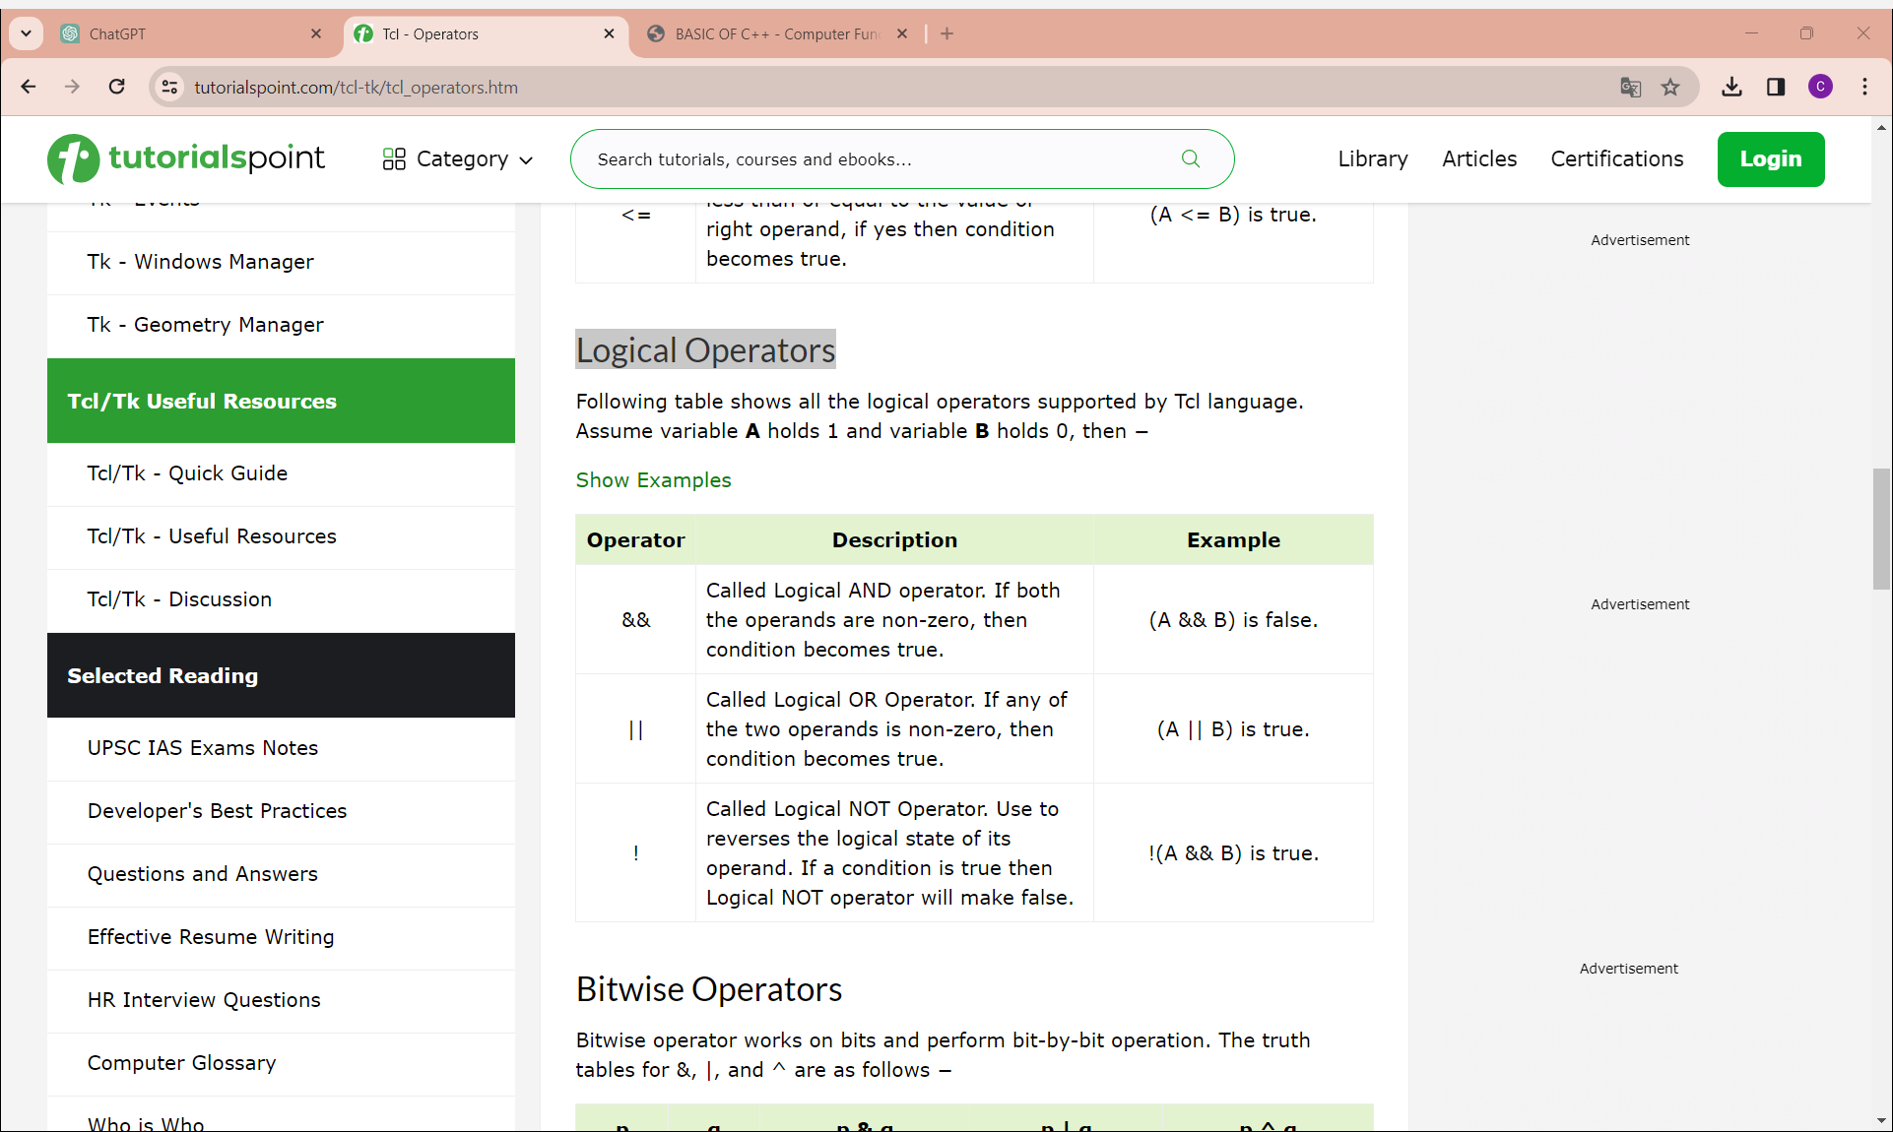
Logical Operators
logical operators can be used in conditional statements or expressions to evaluate multiple conditions.
Assume variable A holds 1 and variable B holds 0, then −
EX:
set x 5
set y 10
if {$x > 0 && $y < 20} {puts "Both conditions are true."}
set a 15
set b 5
if {$a > 10 || $b < 0} {puts "At least one condition is true."}
set flag false
if {!$flag} {puts "The flag is false."}

Slide 10
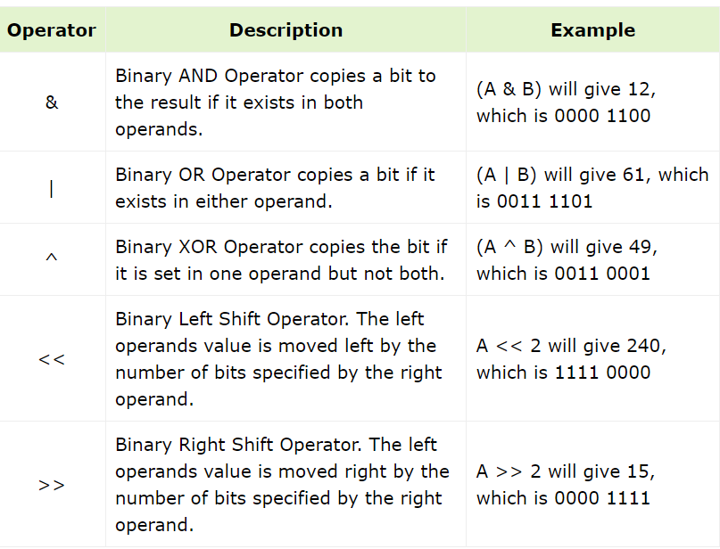
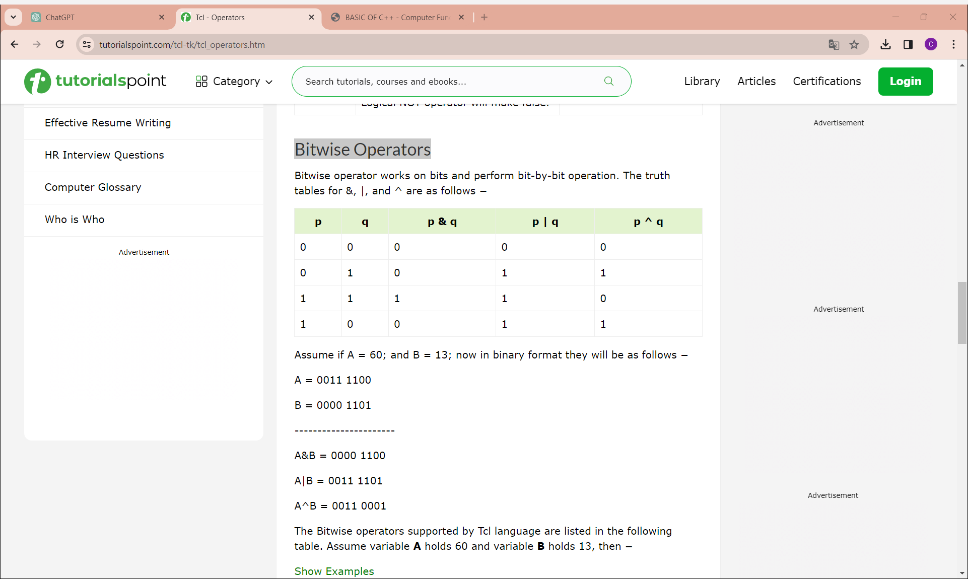
Bitwise Operators
Bitwise operator works on bits and perform bit-by-bit operation. The truth tables for &, |, and ^ are as follows −
Assume if A = 60; and B = 13; now in binary format they will be as follows −
A = 0011 1100
B = 0000 1101
----------------------
A&B = 0000 1100
A|B = 0011 1101
A^B = 0011 0001

Slide 11
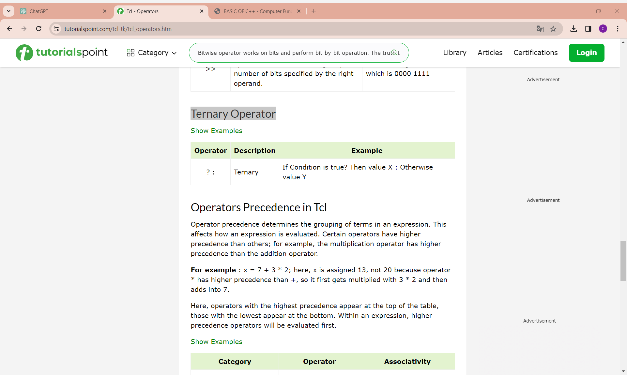
Ternary Operator
Ex:
set x 10
set result [expr {$x > 5 ? "Greater than 5" : "Not greater than 5"}]
puts $result
In this example, the expr command is used to evaluate the ternary condition $x > 5. If it is true, the result is set to "Greater than 5"; otherwise, it is set to "Not greater than 5". The result is then printed.

Slide 12
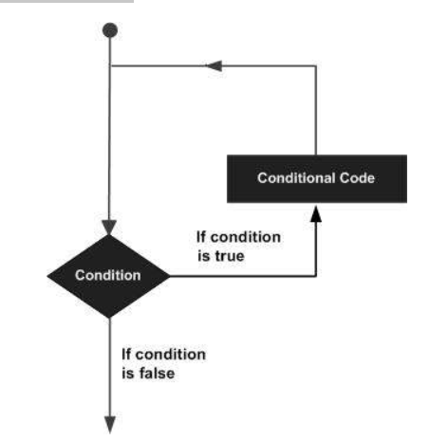
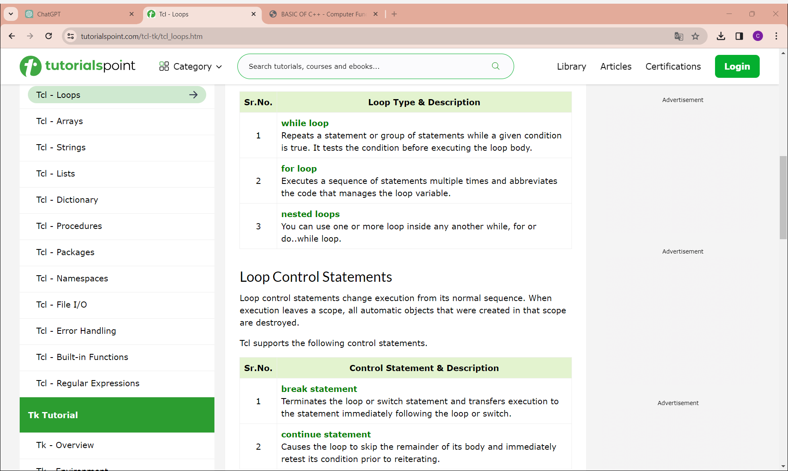
Tcl - Loops
A loop statement allows us to execute a statement or group of statements multiple times and following is the general form of a loop statement in most of the programming languages −

Slide 13
Tcl – Loops(cont)
1.For Loop: The for loop is used for iterating a specific number of times.
Syntax: for {initialize} {condition} {next} {
# Body of the loop }
Ex: for {set i 1} {$i <= 5} {incr i} {
puts "Iteration $i“ }
2.While Loop: The while loop is used for iterating as long as a specified condition is true.
Syntax: while {condition} {
# Body of the loop }
Ex: set j 1
while {$j <= 5} {
puts "Iteration $j"
incr j
}
3.Foreach Loop: The foreach loop is used for iterating over elements in a list.
Syntax: foreach variable list { EX:
# Body of the loop
}
Ex: set fruits {apple banana cherry}
foreach fruit $fruits {
puts "Current fruit: $fruit"
}

Slide 14
Arrays
An array is a systematic arrangement of a group of elements using indices. The syntax for the conventional array is shown below.
Basic operations performed on Arrays:
1.Creating an Array:
array set myArray {
key1 value1
key2 value2
key3 value3
}
3.Modifying Array Elements:
set myArray(key2) newValue
2.Accessing Array Elements:
set value $myArray(key1)
4.Checking if a Key Exists in an Array:
if {[info exists myArray(key3)]} {
puts "Key 'key3' exists in the array."
} else {
puts "Key 'key3' does not exist in the array."
}

Slide 15
Arrays(cont)
Example code Arrays
# Creating an array
array set fruits {
apple red
banana yellow
cherry red
}
# Accessing and modifying array elements
set color $fruits(banana)
puts "Color of banana: $color"
set fruits(cherry) green
# Iterating over array elements
foreach key [array names fruits] {
set value $fruits($key)
puts "$key: $value"
}
# Checking if a key exists
if {[info exists fruits(grape)]} {
puts "Grape exists in the array."
} else {
puts "Grape does not exist in the array."
}
# Deleting an element from the array
unset fruits(apple)
5.Deleting an Element from an Array:
unset arrayName(key)
6. Size of Array:
[array size variablename]

Slide 16
Strings
The primitive data-type of Tcl is string and often we can find quotes on Tcl as string only language. These strings can contain alphanumeric character, just numbers, Boolean, or even binary data. Tcl uses 16 bit unicode characters and alphanumeric characters can contain letters including non-Latin characters, number or punctuation.
String Representations
Unlike other languages, in Tcl, you need not include double quotes when it's only a single word.
When we want to represent multiple strings, we can use either double quotes or curly braces.
Ex:
set myVariable "hello world"
puts $myVariable
set myVariable {hello world}
puts $myVariable

Slide 17
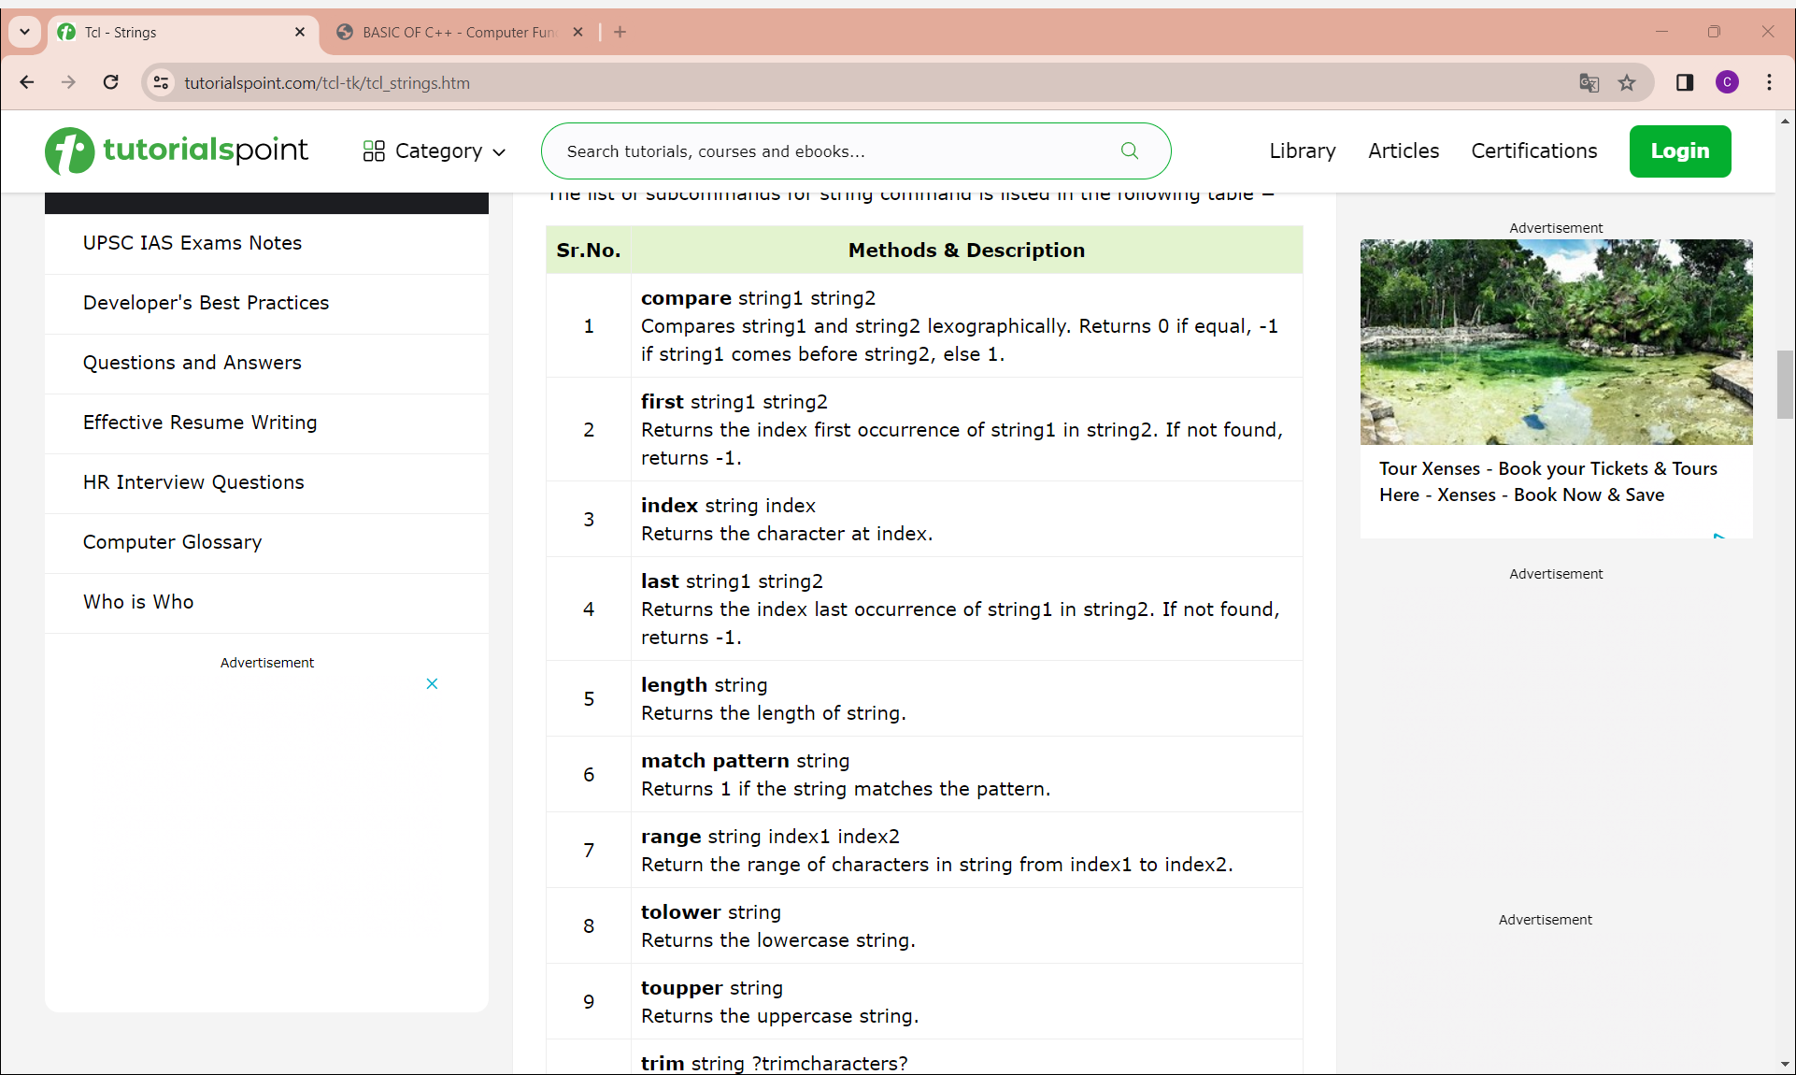
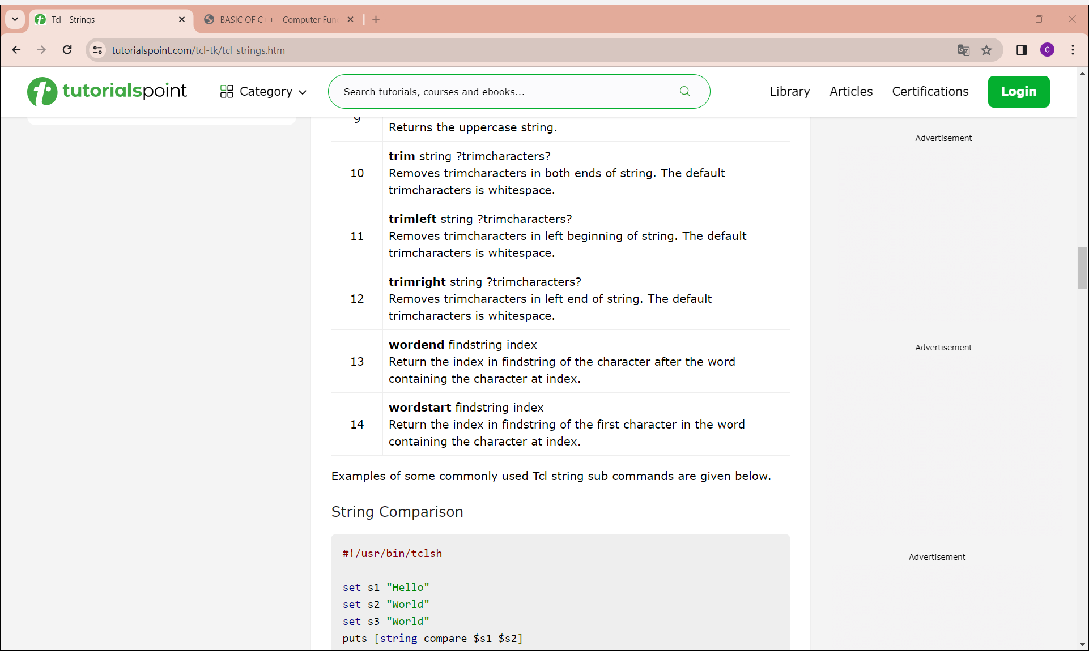
Strings(cont)

Slide 18
Lists
List is one of the basic data-type available in Tcl. It is used for representing an ordered collection of items. It can include different types of items in the same list. Further, a list can contain another list.
Creating a List:
set listName { item1 item2 item3 .. itemn }
# or
set listName [list item1 item2 item3]
# or
set listName [split "items separated by a character" split_character]
2. Appending Item to a List:
append listName split_character value
# or
lappend listName value

Slide 19
Lists(cont)
3. Length of List:
Syntax: llength listName
4. List Item at Index:
Syntax: lindex listname index
5. Insert Item at Index:
Syntax: linsert listname index value1 value2..valuen
6. Replace Items at Indices:
Syntax: lreplace listname firstindex lastindex value1 value2..valuen
7. Set Item at Index:
Syntax: lset listname index value
8. Transform List to Variables:
Syntax: lassign listname variable1 variable2.. Variablen
9. Sorting a List: This command will sort the lists in ascending order.
Syntax: lsort listname

Slide 20
File handing
Tcl supports file handling with the help of the built in commands open, read, puts, gets, and close.
A file represents a sequence of bytes, does not matter if it is a text file or binary file.
Opening Files:
Tcl uses the open command to open files in Tcl. The syntax for opening a file is as follows −
Syntax: open fileName accessMode
Closing a File:
To close a file, use the close command. The syntax for close is as follows −
Syntax: close fileName
Reading a File:
Following is the simple command to read from a file −
Syntax: set file_data [read $fp]
Writing a File:
Puts command is used to write to an open file.
puts $filename "text to write"

Slide 21
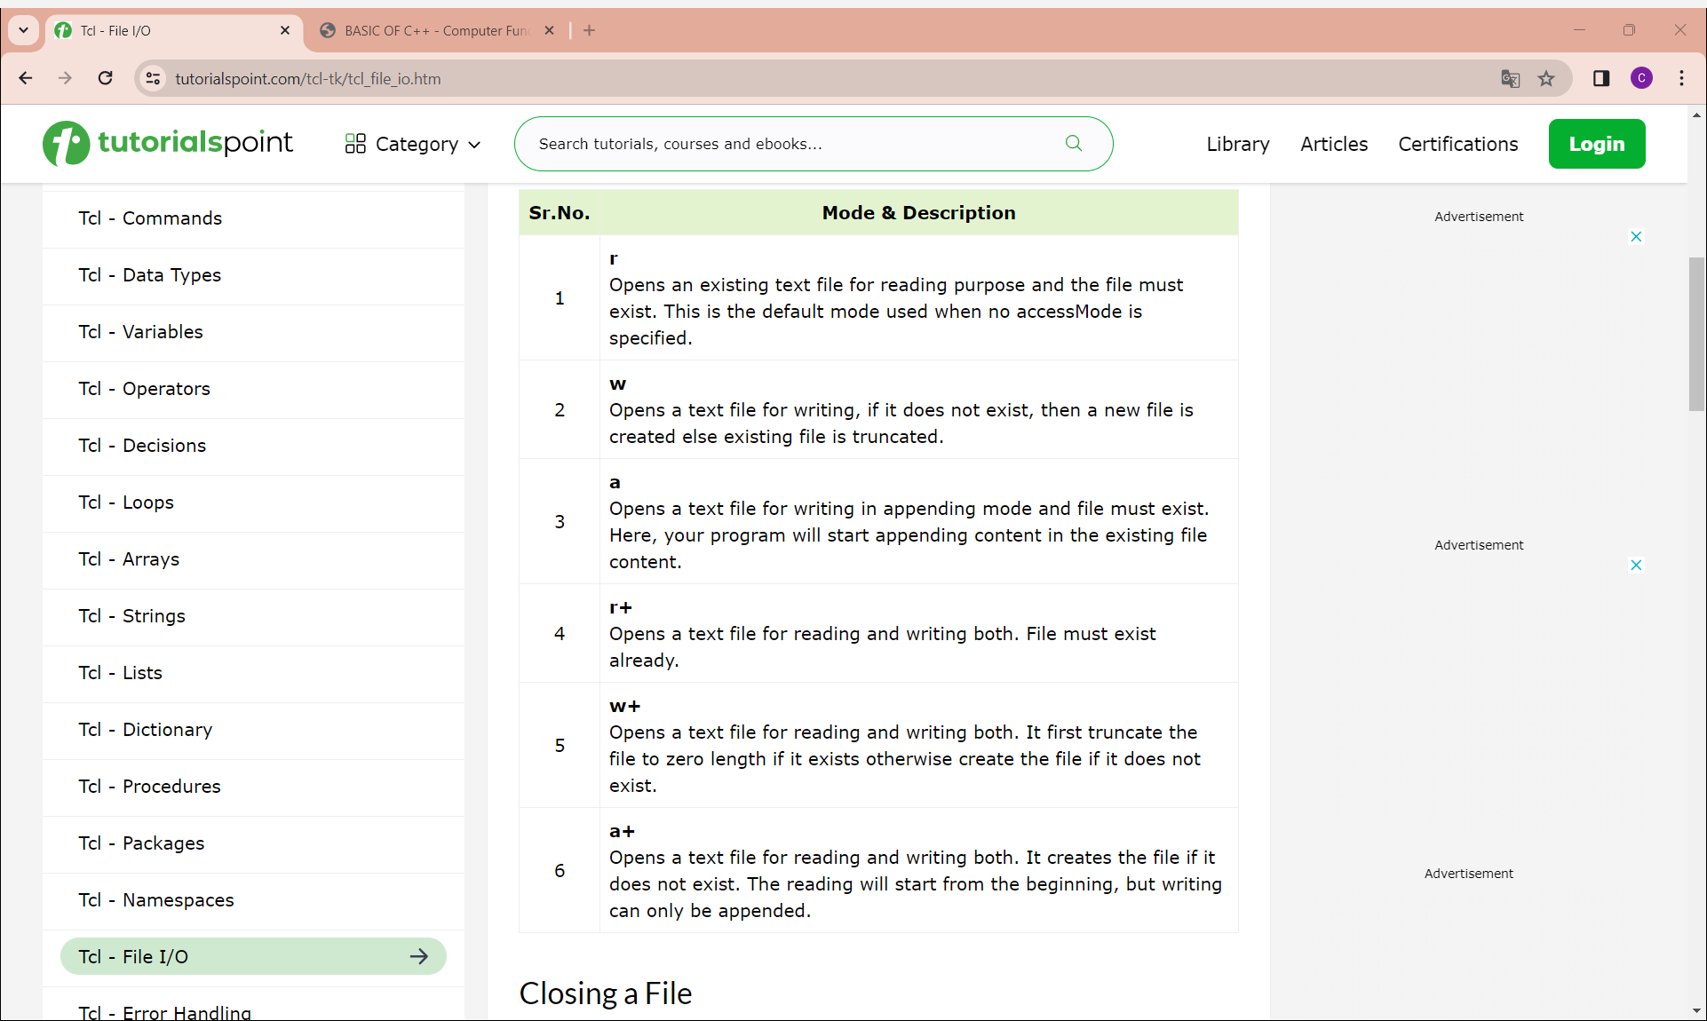
Access Modes for Files

Slide 22
Regular Expressions
The "regexp" command is used to match a regular expression in Tcl. A regular expression is a sequence of characters that contains a search pattern. It consists of multiple rules and the following table explains these rules and corresponding use.
Syntax:
regexp ?switches? pattern string ?matchVar? ?subMatchVar subMatchVar ...? switches
Optional switches that modify the behavior of the regular expression matching.
pattern: The regular expression pattern to match against.
string: The string to be tested for a match.
matchVar: Optional variable to store the entire matched substring.
subMatchVar subMatchVar ...: Optional variables to store matched substrings corresponding to capturing groups in the pattern.

Slide 23
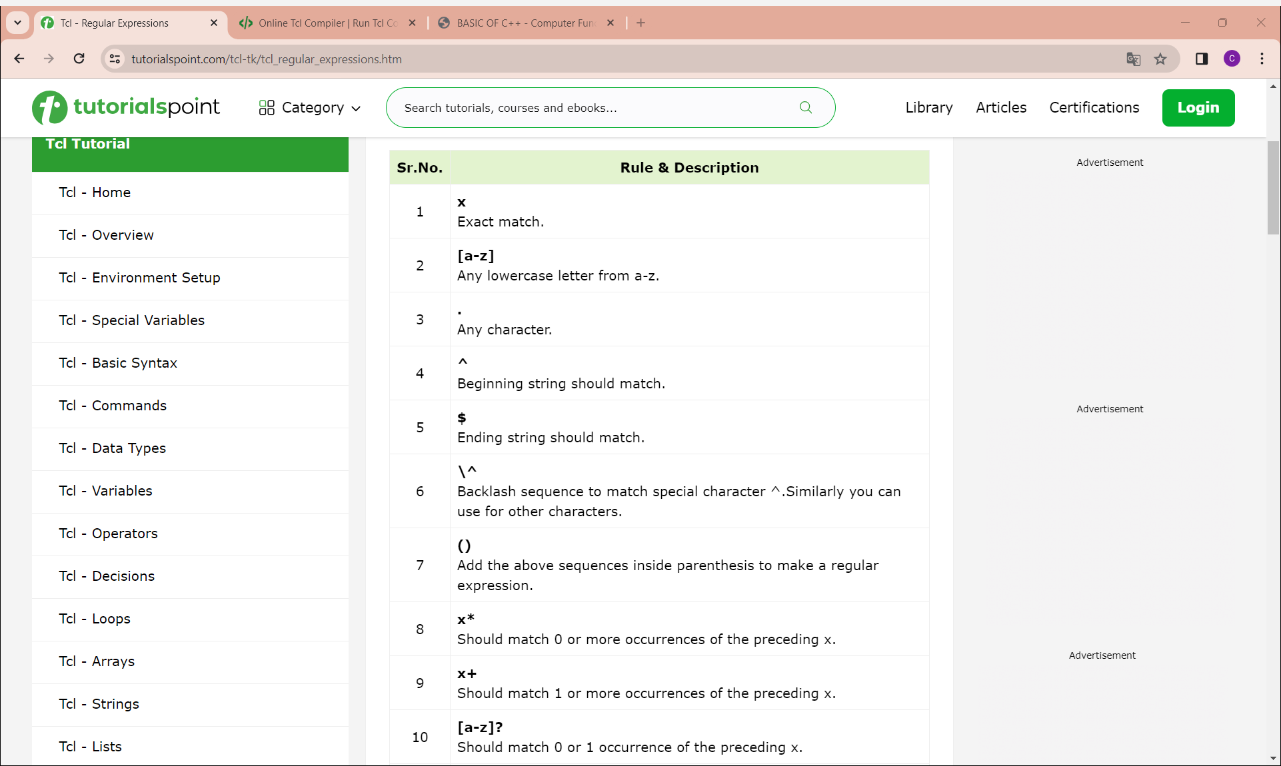
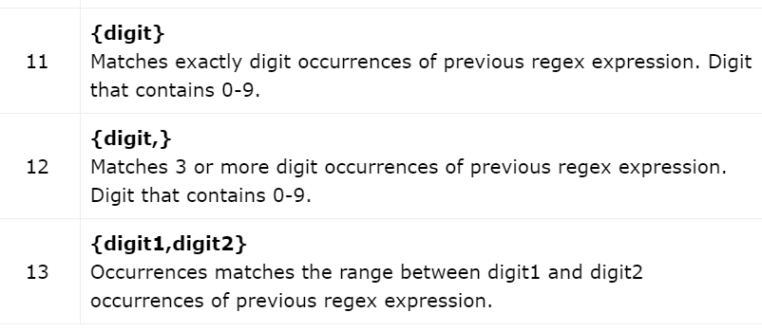
Regular Expressions(cont)

Slide 24
Regular Expressions(cont)
Output:
Full Match: Tcl
Sub Match1: Tcl
Ex1: regexp {([A-Za-z]*)} "Tcl Tutorial" a b
puts "Full Match: $a"
puts "Sub Match1: $b“
Ex2:Multiple Patterns
regexp {([A-Za-z]*).([A-Za-z]*)} "Tcl Tutorial" a b c
puts "Full Match: $a"
puts "Sub Match1: $b"
puts "Sub Match2: $c"
Output:
Full Match: Tcl Tutorial
Sub Match1: Tcl
Sub Match2: Tutorial

